Slide 1

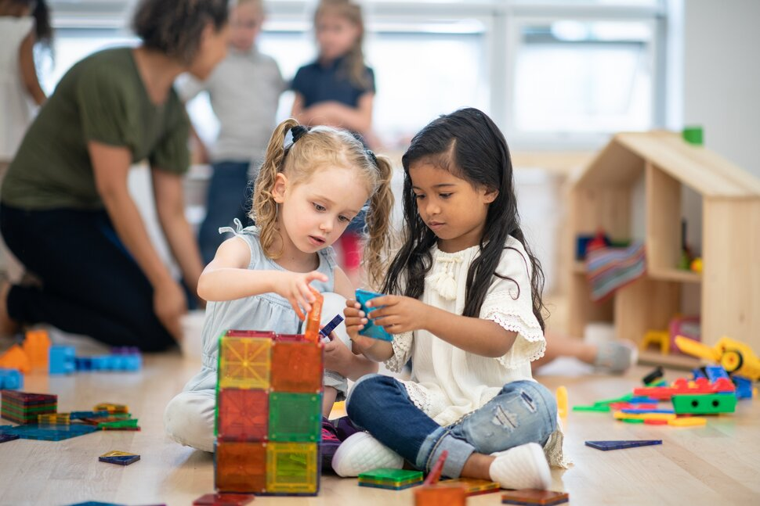
Mind Makers

Slide 2

OBJECTIVE
Discover KIDS’ Skills
Increase Brain Cognitive Skills.
Teach Them New Skills (programming)
Increase Kid Self Awareness

Slide 3

Targeted Age
Kids: From Two to Five Years
Youngs: From Six to Ten Years

Slide 4
Why OUR PROGRAMS
MIND MAKERS

Slide 5

Our Features
Affordable Course Price
Talented Kind Instructors
8 Years of Experience in Teaching Kids
Breakfast and lunch for each kid

Slide 6

Humans Discover only 28% of His Skills In Their Lifetime!!

Slide 7

Kids Learning CYCLE
EXPLAIN
SHOW
ACTING

Slide 8
OUR Programs
MIND MAKERS

Slide 9
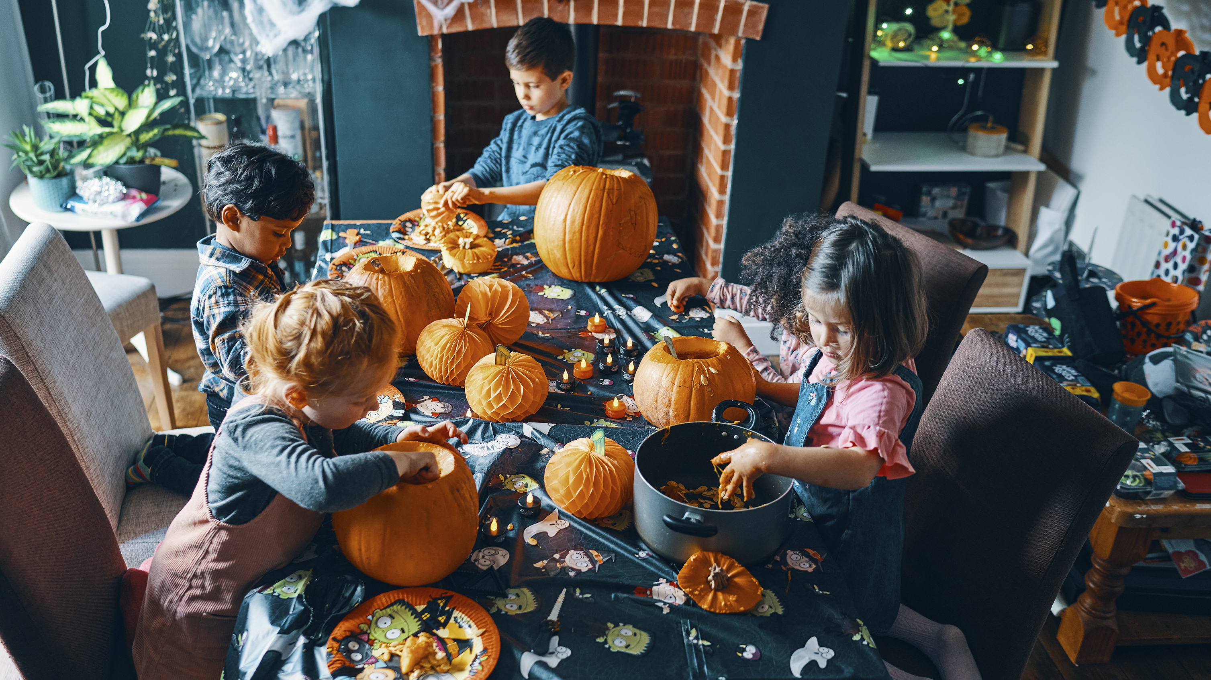
Kids Programs
Counting Numbers
Art Coloring Picture |
Practice Singing
Reading & Writing
Group Games

Slide 10
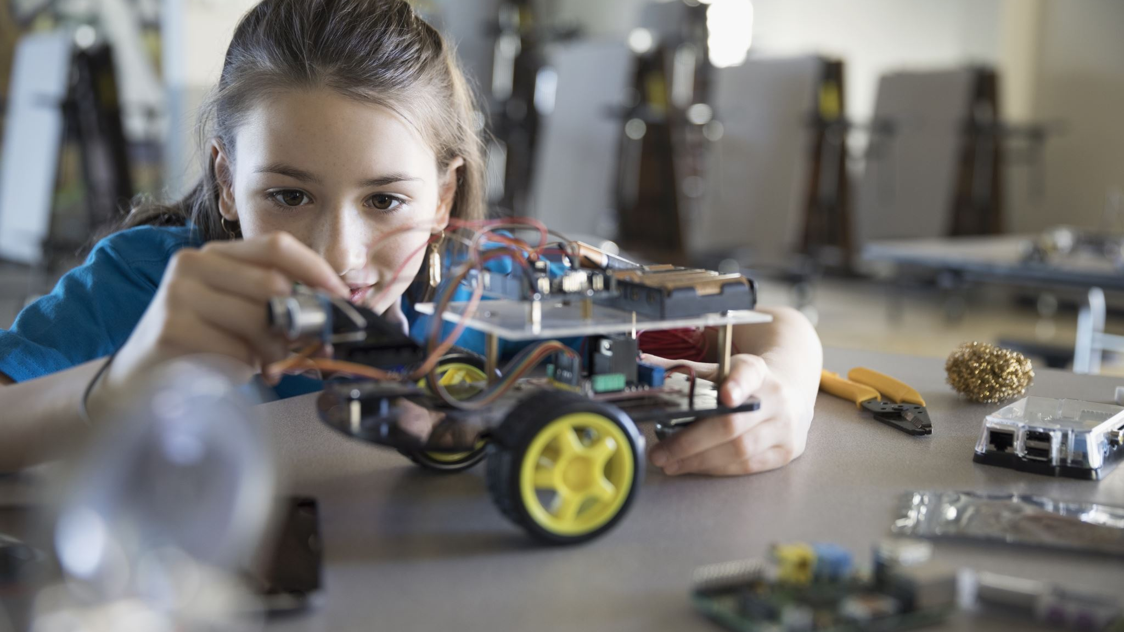
Youngs Programs
Handmade Craft
Art Drawing Pictures ||
Mathematic
Learning Basic Programming
Meditation & Mindfulness

Slide 11
Pricing
MIND MAKERS

Slide 12
Pricing List
Kids: 999 E.G / Month
Youngs: 1299 E.G / Month
Plus 30% Offer For First 50 Child

Slide 13

Contact us
MindMakers@gmail.com

